Slide 1


We are #1
Sprint Review #2
Notes:
Put a nice graphic here

Slide 2

The Team
Rob O’Connor Project Managar, 3D Artist & Technical Artist
Tamara Hooijmans Concept Artist & 2D UI Artist
Humam Abud Allah Concept Artist & Sound Designer
Olivier de Haan Concept Artist, Designer & 3D Artist
Rick Oosthof Game Designer, UI Designer & Unity Scripter
Glyn Leine Gameplay Programming
Notes:
Put proper roles here

Slide 3
Last week’s next week
“Next week we want to have an unpolished version of the game”
Start Trailer Production
Gameplay: Levels, Death, Powerup, Upgrading, UI
Further Prototyping & Testing
Audio Production
3D Models
2D Art
Notes:
Last week’s next week AKA did we achieve our goal?

Slide 4
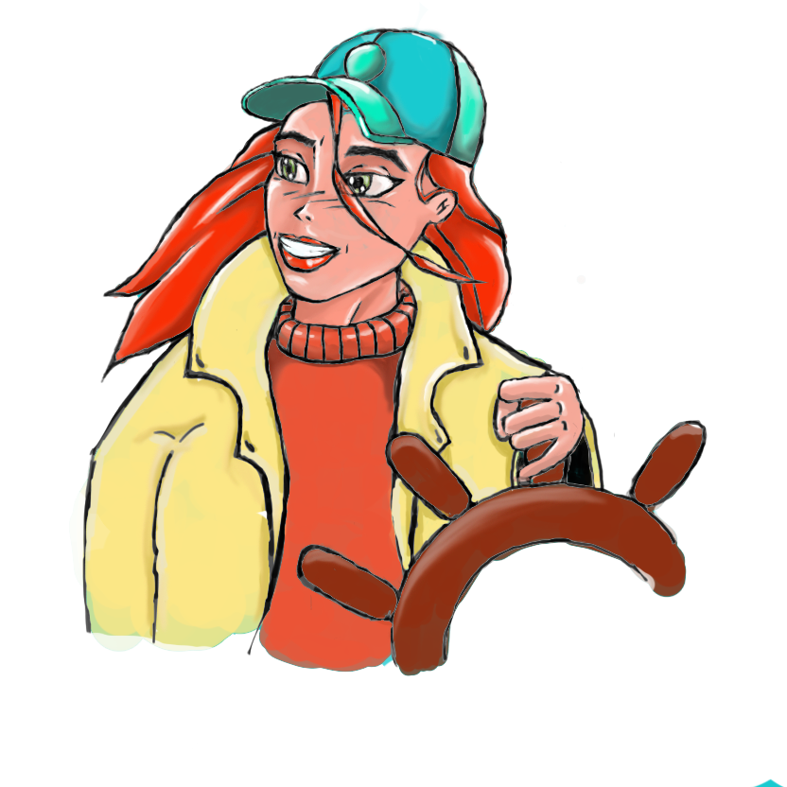
Changes from last week
Characters
Cleanliness instead of money
Start screen cleaner
Fish
Notes:
What did we change about the game?

Slide 5
Testing
UI Test
Gameplay demo test
Is it clear?
Is it fun?
Would you want to play the finished product?
What would you change?
Notes:
Press next slide to reveal graph

Slide 6
Testing
UI Test
Gameplay demo test
Is it clear?
Is it fun?
What would you change?
Notes:
A lot of the feedback we got was things we were already going to implement like dialogue and goals, as well as art variety being a big suggestion
Some interesting suggestions we got however were: More art/stuff in the background to keep the scene entertaining & hazards that do interesting things(E.G. chase or slow you down if you hit them)

Slide 7
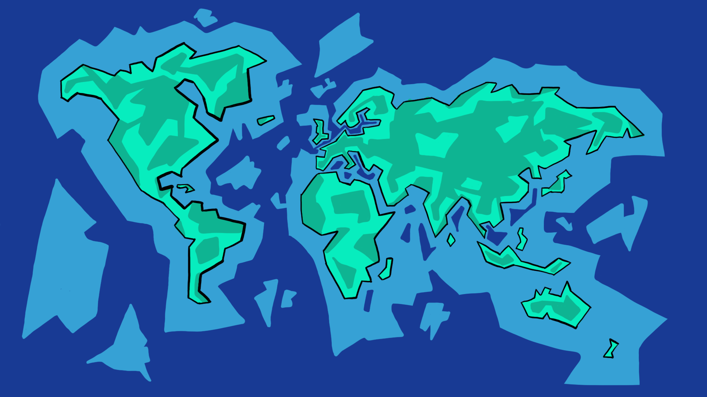

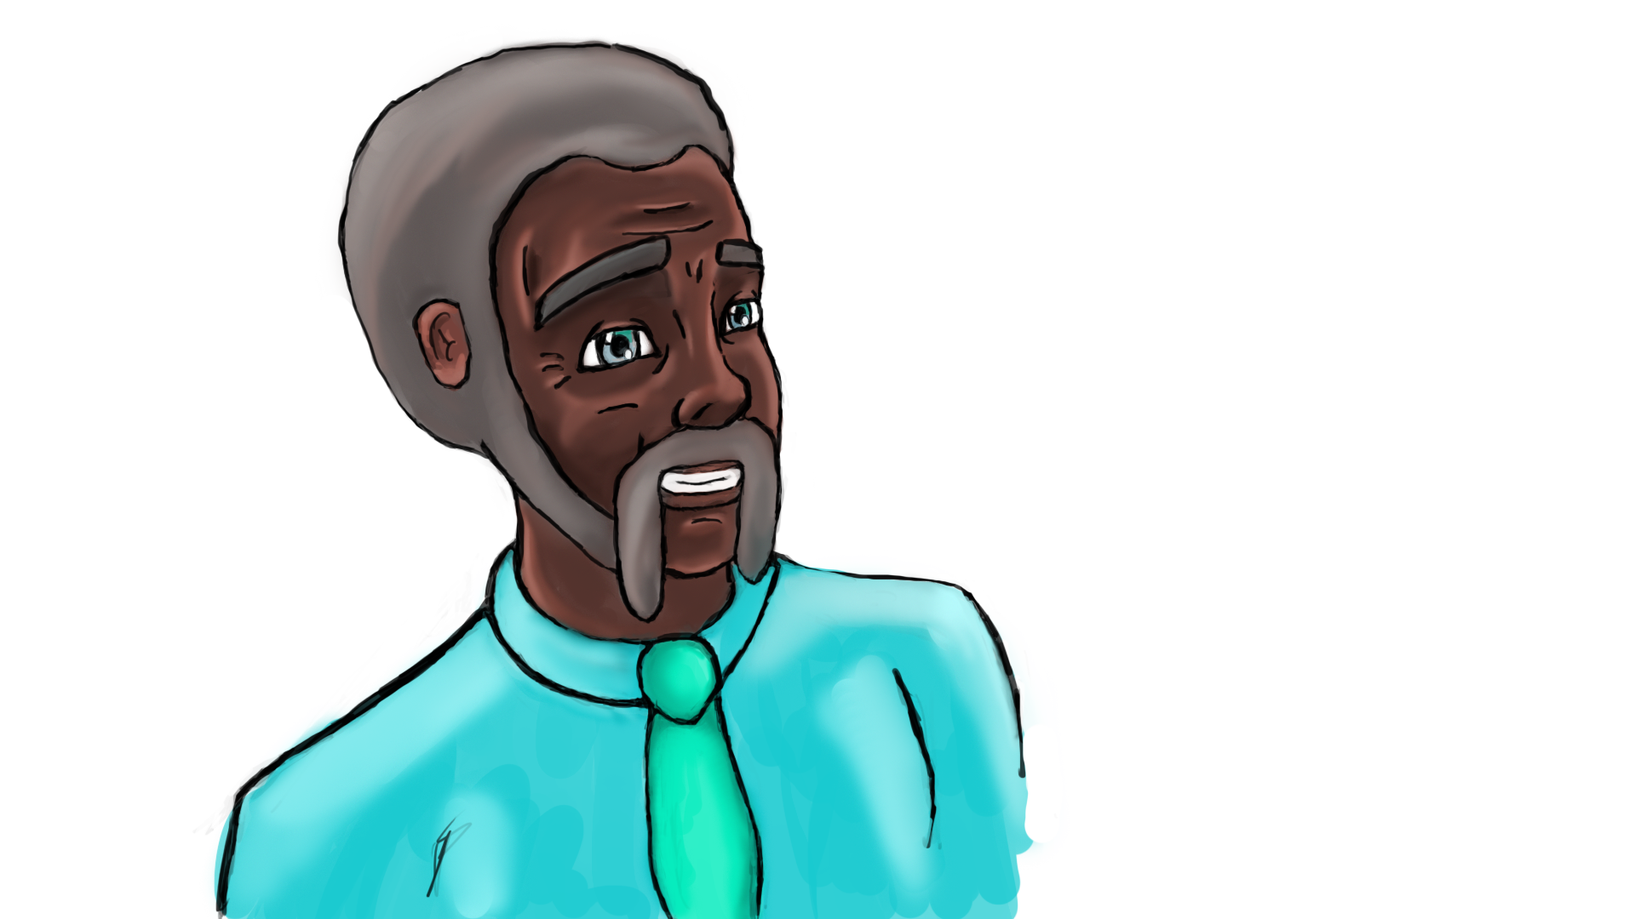





Notes:
UI Art 1

Slide 8














Notes:
UI Art 2.0

Slide 9
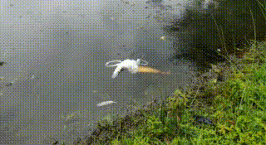
Trailer production
Fully filmed, ready for editing
Follows the story of a plastic bag
Ends with the message

Slide 10

Audio
Sound Effects
Menu Music

Slide 11
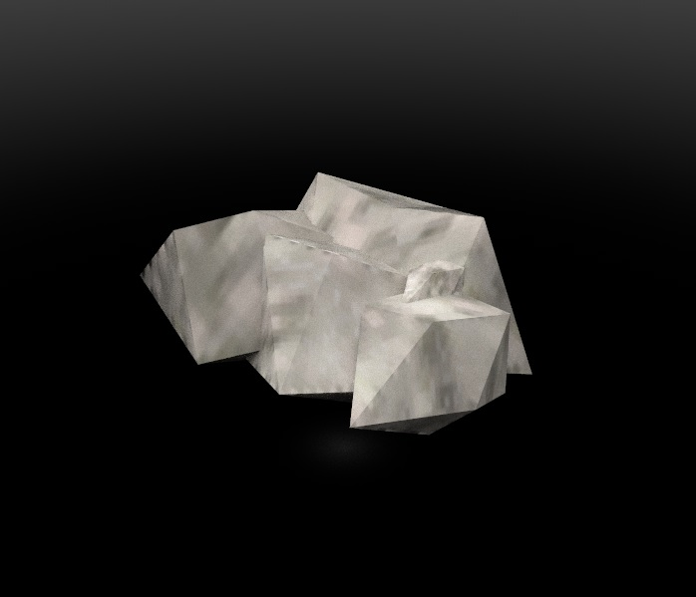
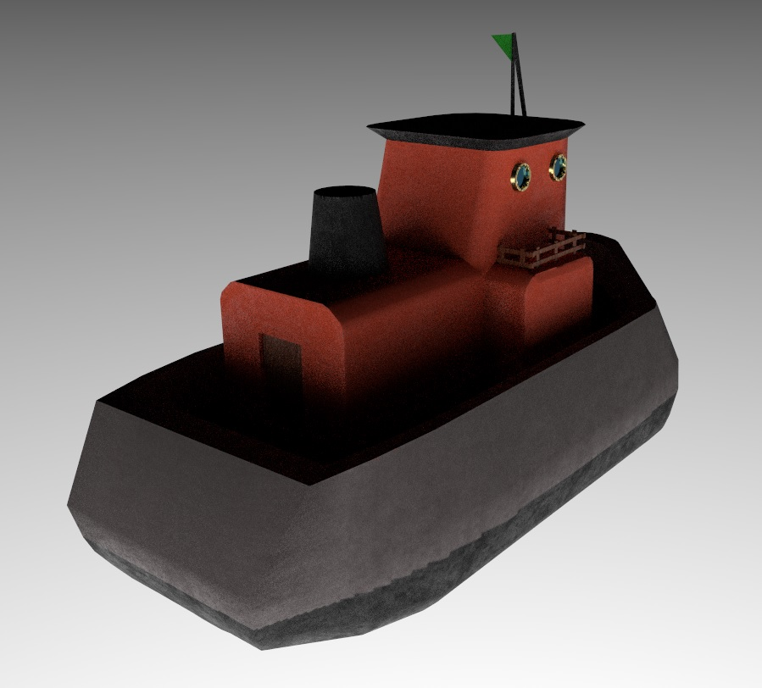
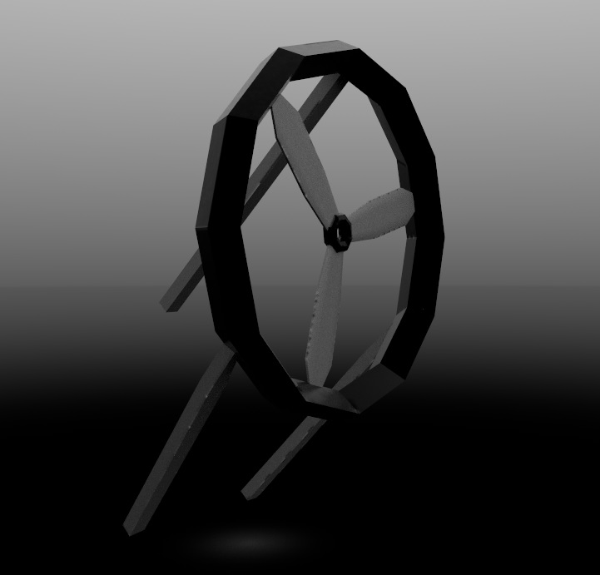
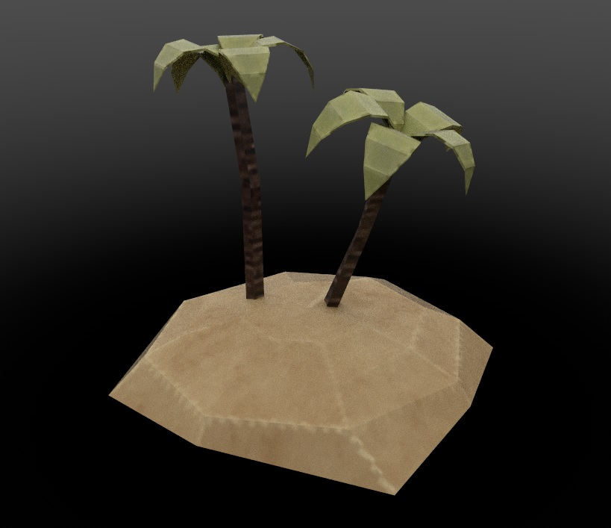
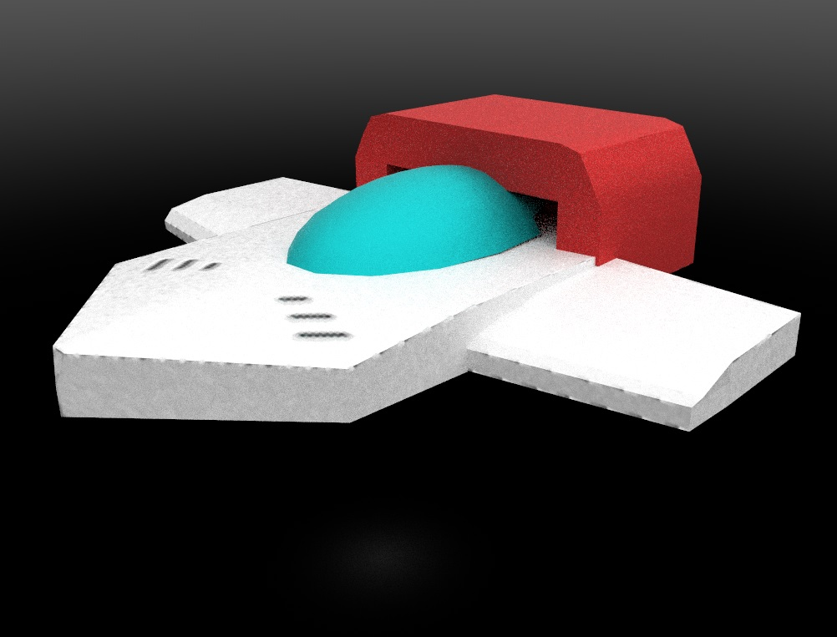
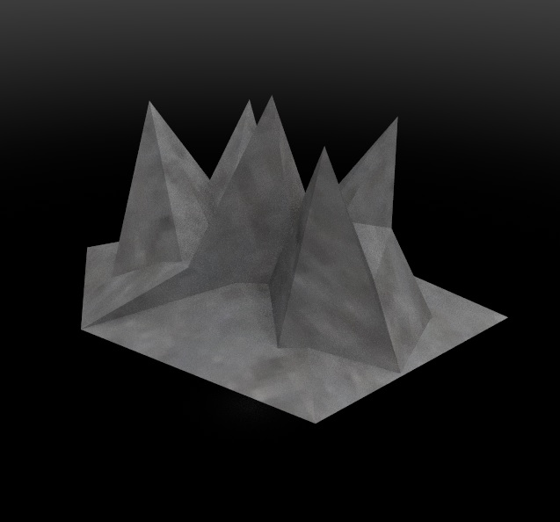

Slide 12
Next week
Next week we want to have a finished and polished product
UI polishing
Dialogue
Trailer editing
Balancing
Audio Production
Notes:
Next week sprint backlog, what are we planning on doing next week?(nice quick fire list)

Slide 13
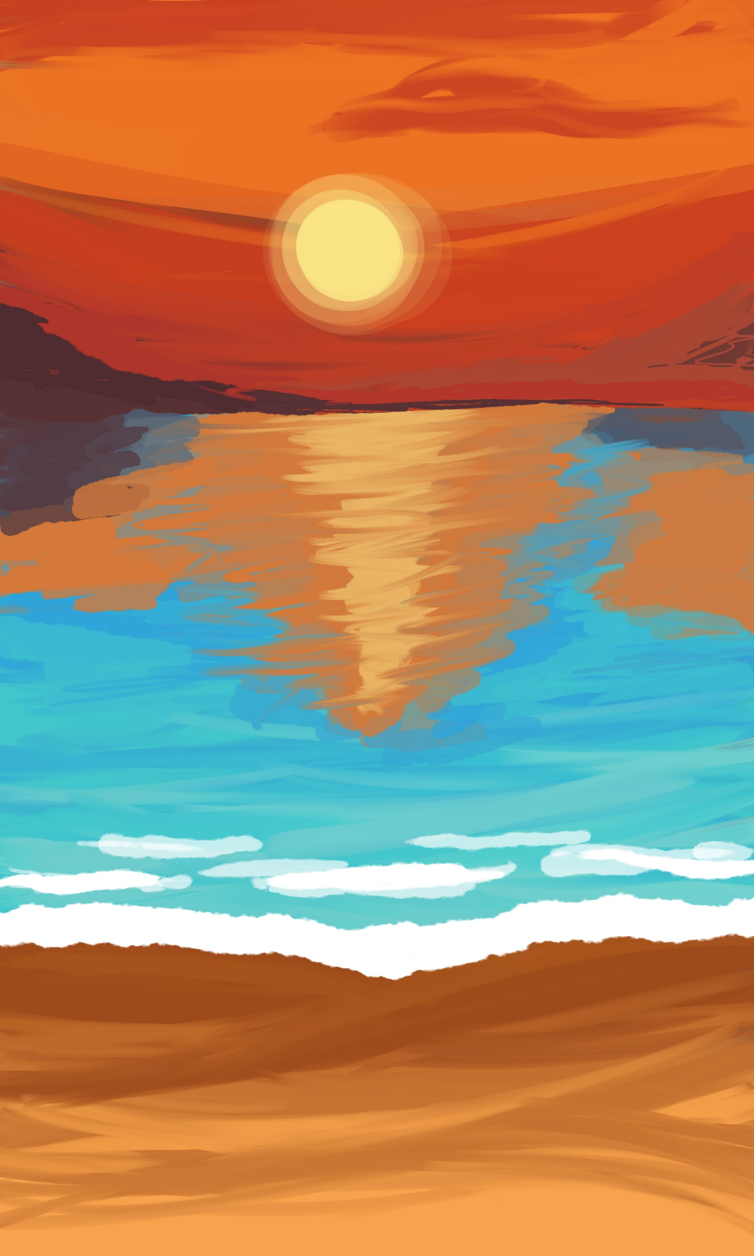
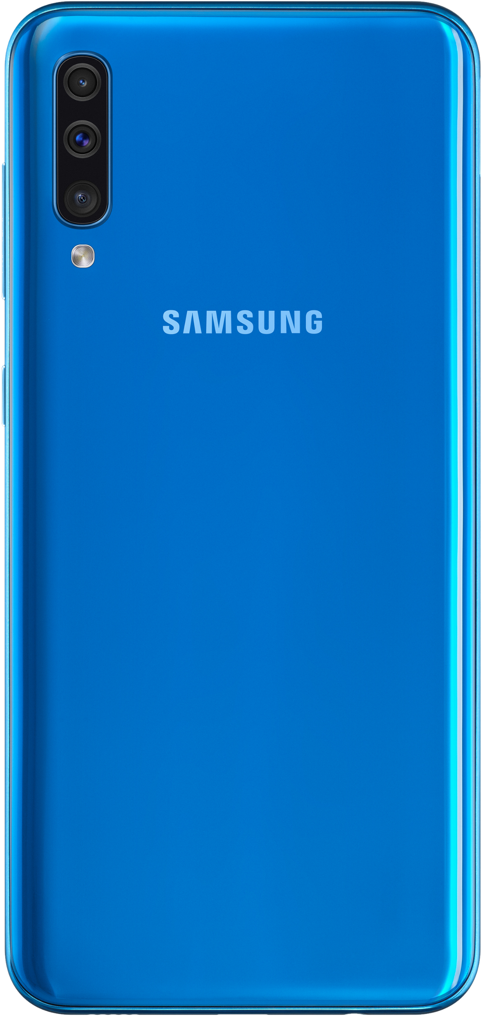
Gameplay

Slide 14

Thank you for listening

